Slide 1
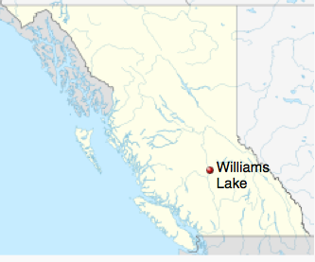
Case #2 Regina V Girard
Nicole Girard caused the death of Kevin Steel at Williams Lake on October 29, 1989 at approximately 02:07 hours.
Girard caused the death of Steel by shooting him with a rifle in the back of the head.
Any admissions and statements Girard gave were made voluntarily and none of the rights accorded to criminal suspects by the Canadian Charter of Rights and Freedoms were infringed or violated.

Slide 2
Case #2 Regina V Girard
Girard pleaded self-defence using the battered wife syndrome.
A psychiatrist provided expert testimony explaining how a battered woman might come to the conclusion that murder may be her only way to escape an abusive relationship.
How might the testimony of the psychiatrist affect the outcome of this case? Predictions?

Slide 3
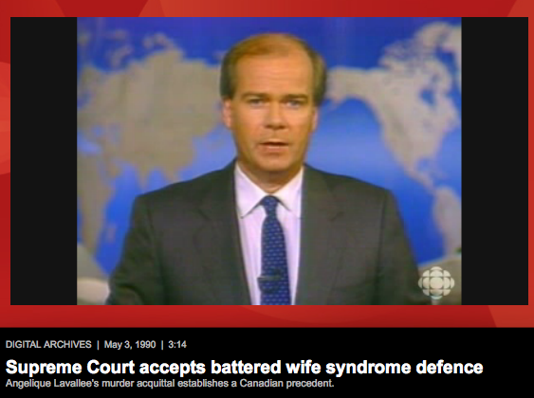
Canadian Cases of Battered Woman Syndrome
In groups, analyse the cases mentioned in the article and discuss the following:
http://www.cbc.ca/news/canada/5-cases-using-the-battered-woman-defence-1.1221150
What evidence supported the accused’s defence?
What details of the crime might make the defence’s case difficult to prove?
In your opinion, should the Battered Woman Syndrome be accepted as a legitimate defence?

Slide 4
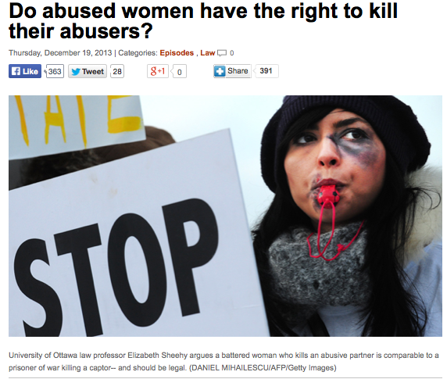
Relevant Legal Issues
To what degree is expert testimony considered?
How are experts qualified and to whom are they responsible?
How do we measure responsibility in culpable homicide cases?
What is acceptable in terms of defenses to murder?
How do we understand and react to domestic abuse?

